Slide 1
Welcome!
Hari Polnati

Slide 2
Collection Framework and Generics

Slide 3
Quick Overview Wrapper Classes
What are Wrapper Classes?
A wrapper class wraps (encloses) around a data type and gives it an object appearance
Wrapper classes are final and immutable.
Types
Wrapper: Boolean,Byte,Character,Double,Float,Integer,Long,Short
Primitive: boolean,byte,char ,double, float, int , long,short
Why Wrapper Classes?
Creation from other data types
Integer hundred = Integer.valueOf("100"); Boolean value = Boolean.valueOf("True");
Autoboxing
Autoboxing is the automatic conversion that the Java compiler makes between the primitive types and their corresponding object wrapper classes.
Auto Boxing uses the static valueOf methods.

Slide 4
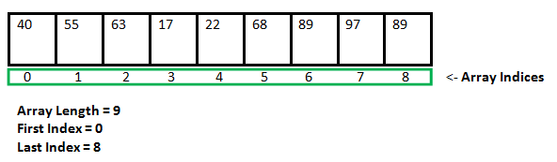
What and Why
Let’s understand Arrays first
Arrays are fixed in size.
Once we create an array there is no way to increase or decrease the size in advance
Homogeneous

Slide 5
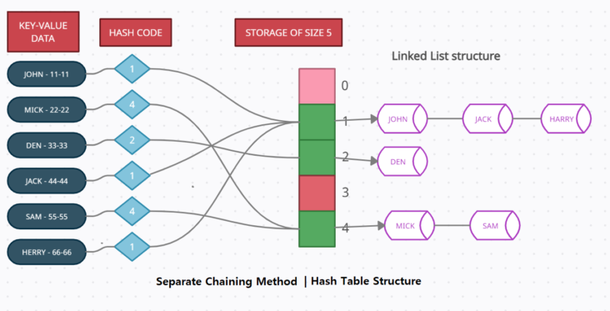
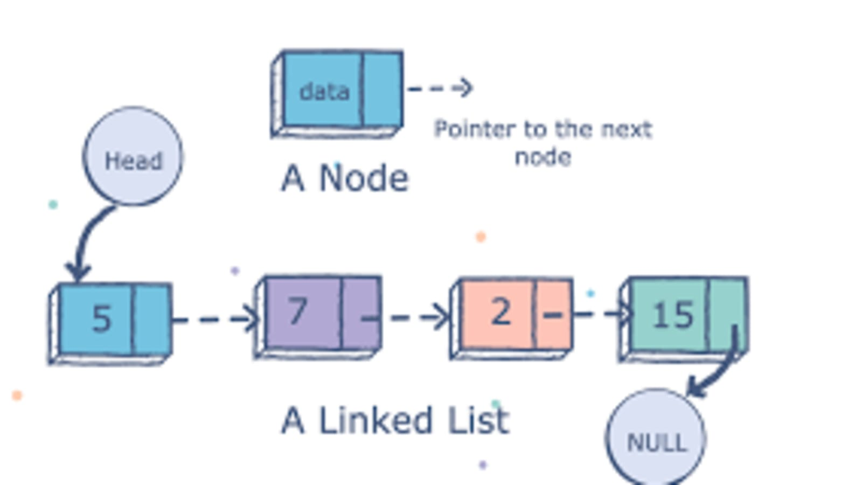
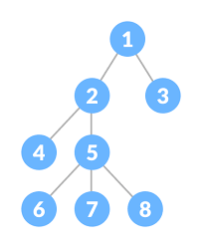
LinkedList
Hashtable
Tree

Slide 6
Collections
We want to focus on data structure or business logic ?
Java provides built in collections
Collections
List - Ordered, Duplicates Allowed
Set - Unordered, Duplicates Not Allowed
Queue - Ordered. FIFO
Map. - Key value pair

Slide 7
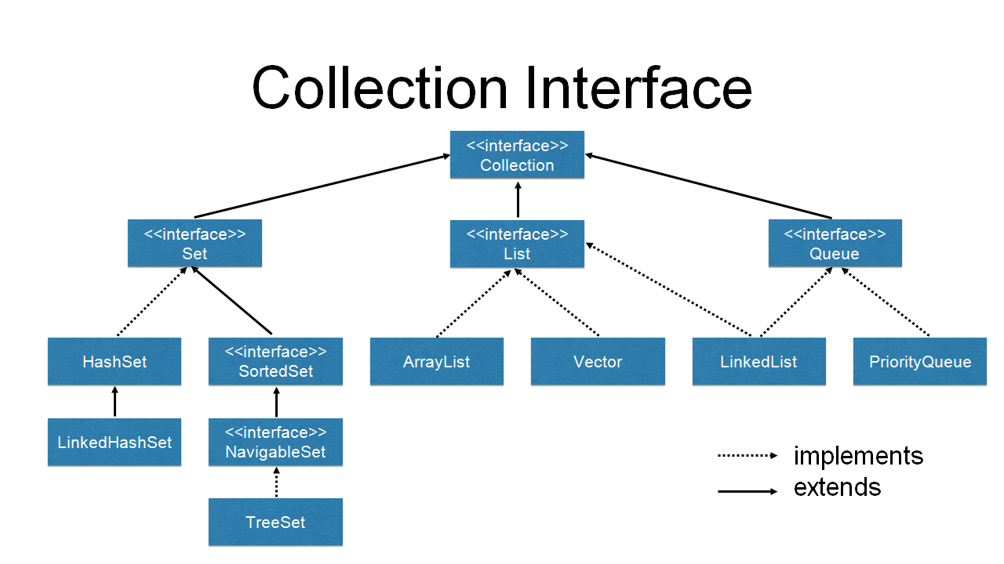
Insertion order preserved. Duplicates Allowed
Insertion order is not preserved. No duplicates
Ordered. All elements get inserted at the "end" and removed from the "beginning" (or head) of the queue

Slide 8
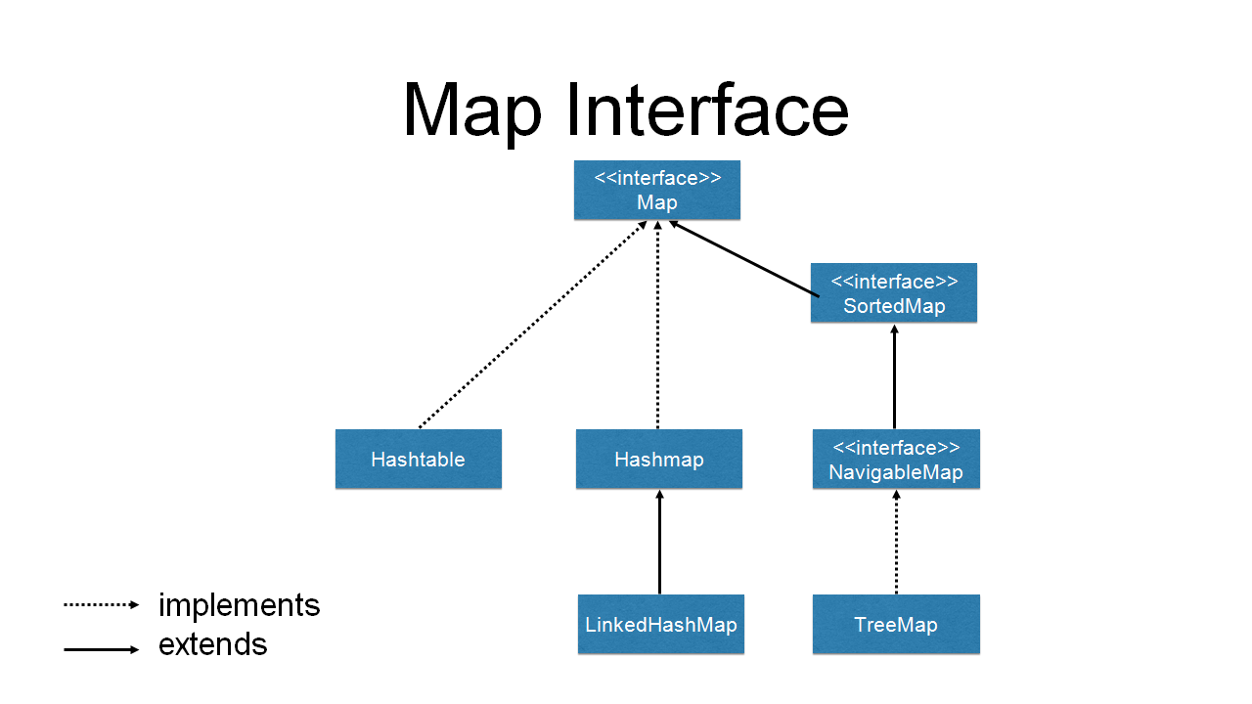
key, value data structure
Un-Sorted
Sorted

Slide 9
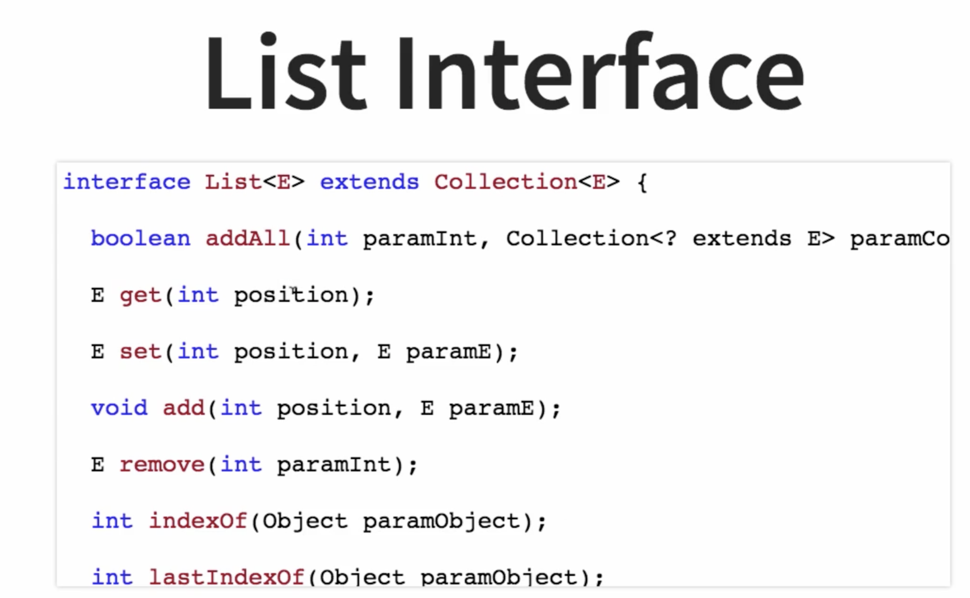

Slide 10
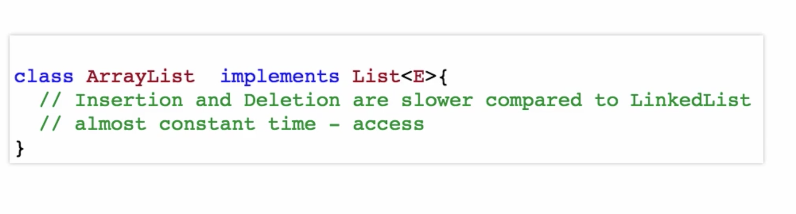
ArrayList (Dynamic array – grow or shrink)

Slide 11
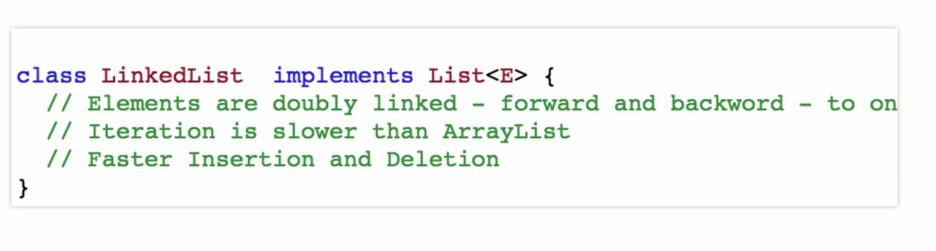
LinkedList (DoublyLinkedList)

Slide 12
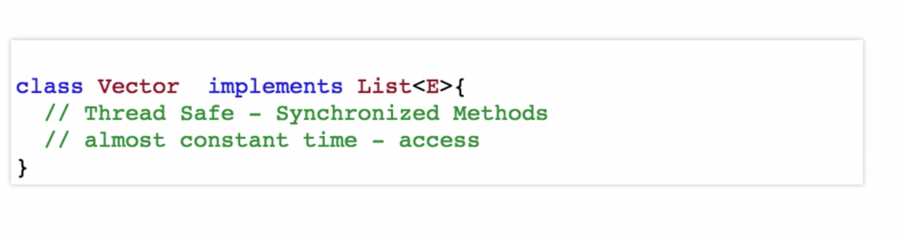
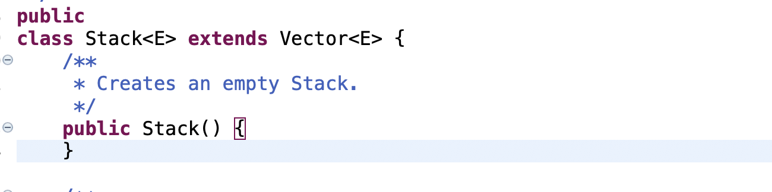
Vector (Dynamic array – grow or shrink)
Stack - LIFO
}

Slide 13
Iteration Approaches for List
Indexed for loop
Enhanced for loop
An Iterator

Slide 14
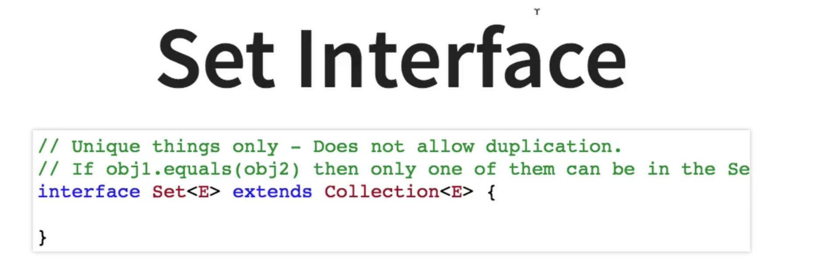

Slide 15
HashSet (Hashtable)

Slide 16
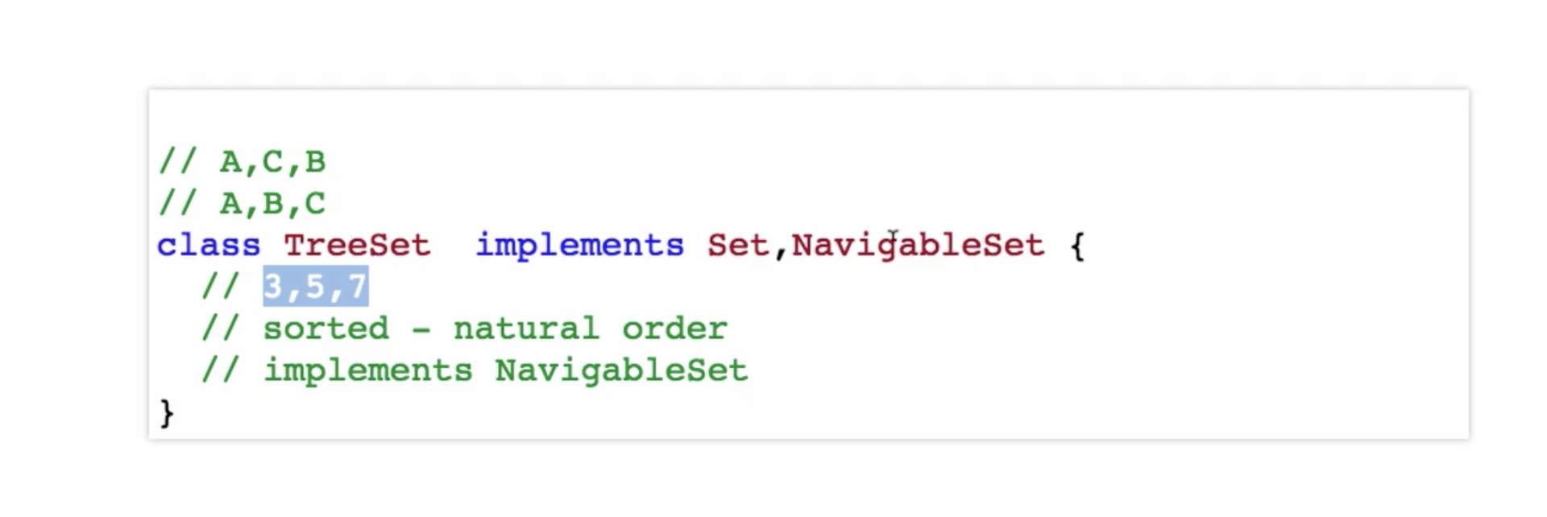
TreeSet (TreeMap (Red-BlackTree))

Slide 17
LinkedHashSet (LinkedHashMap)

Slide 18
Queue
Arranged in order of Processing.
Examples: Calendar Meetings Attendance, Todo –List, Jenkin jobs, Azure Devops tasks
Queue interface extends Collection interface. So, Queue will supports all collection interface methods

Slide 19
PriorityQueue. (Queue with the Heapify technique – Default is Min-Heap)

Slide 20
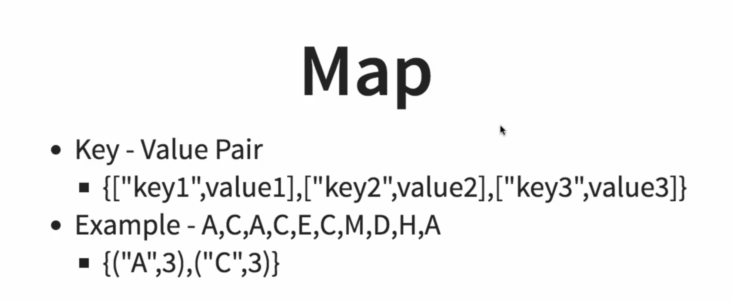

Slide 21
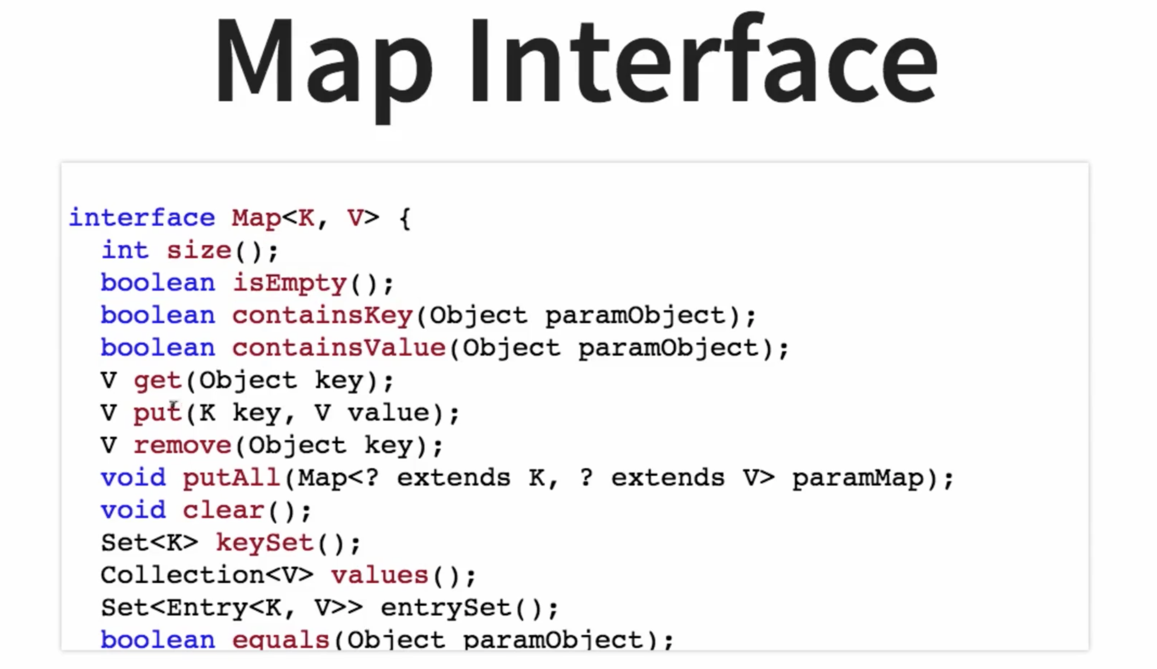

Slide 22
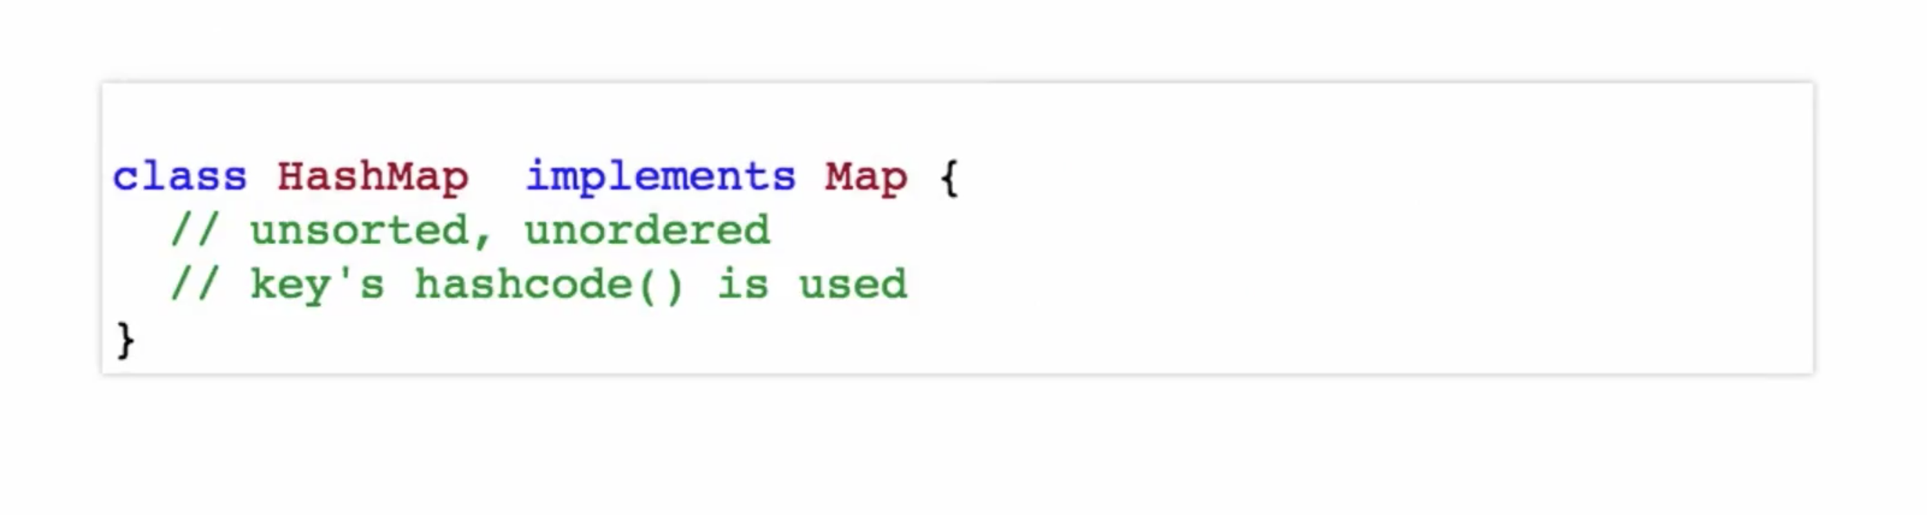
HashMap

Slide 23
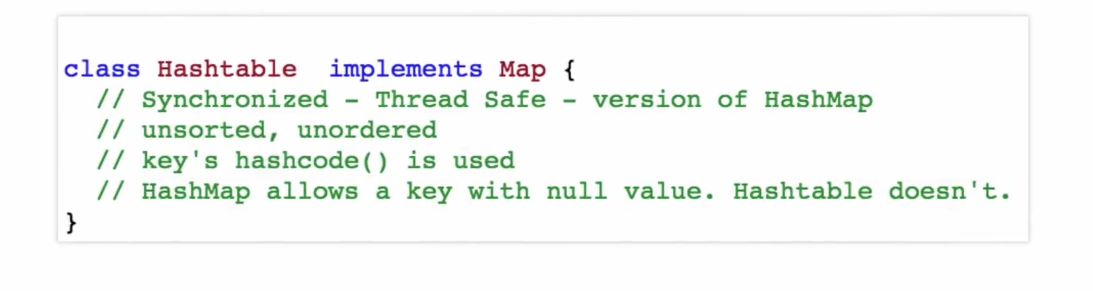
Hashtable

Slide 24
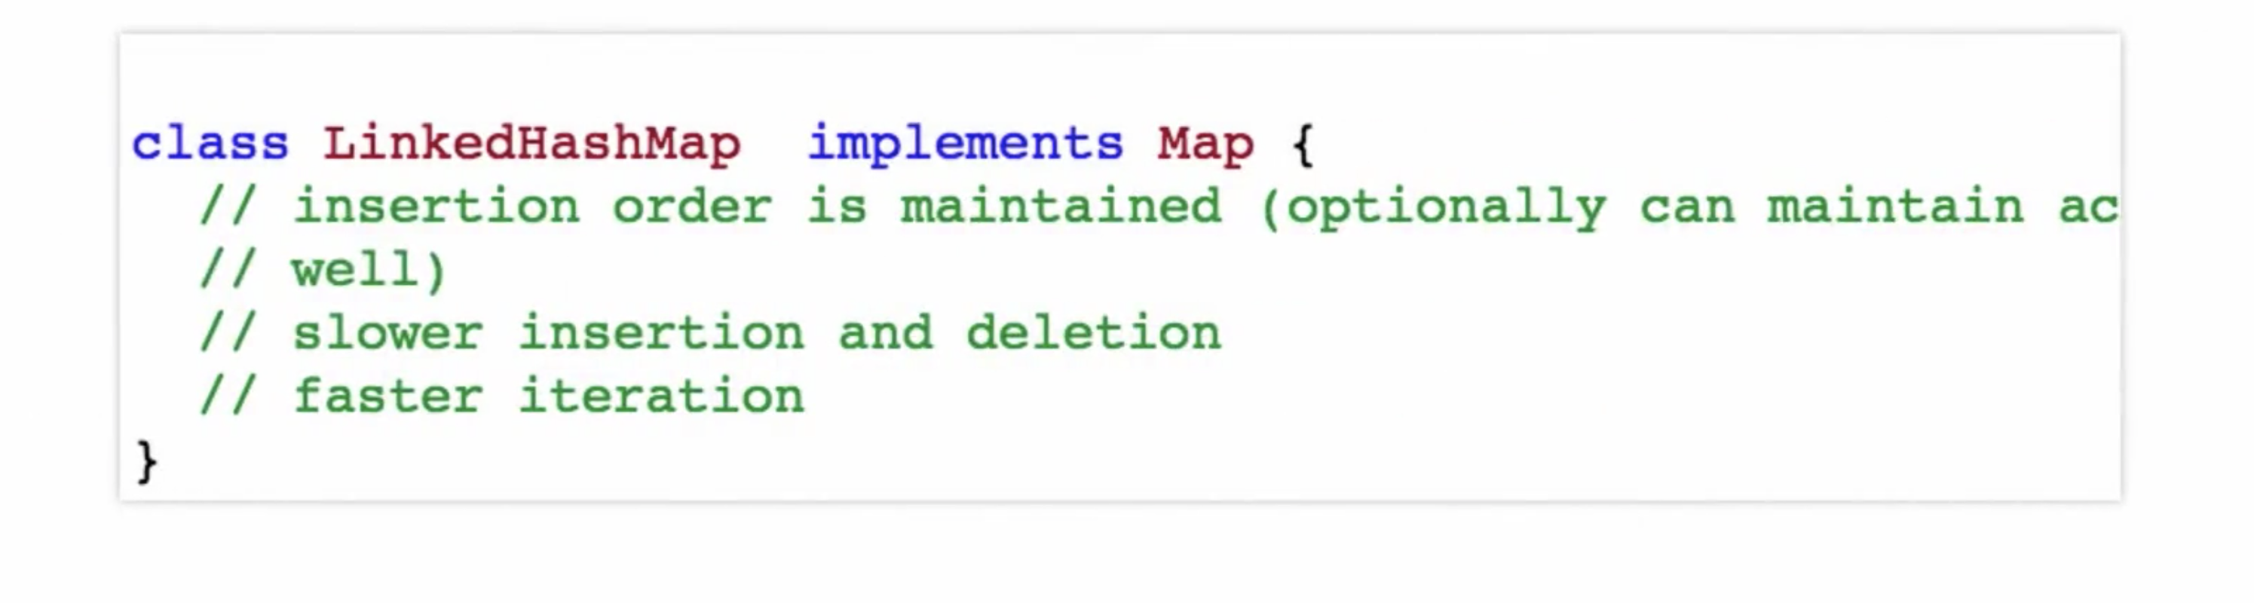
LinkedHashMap

Slide 25
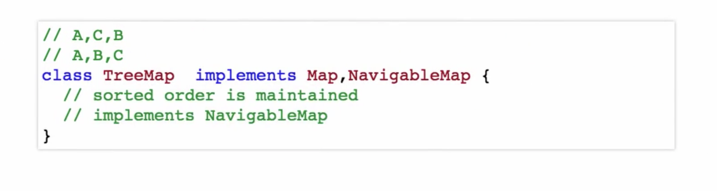
TreeMap

Slide 26
DS Visualization
https://visualgo.net/en
https://www.cs.usfca.edu/~galles/visualization/Algorithms.html
https://bost.ocks.org/mike/algorithms/

Slide 27
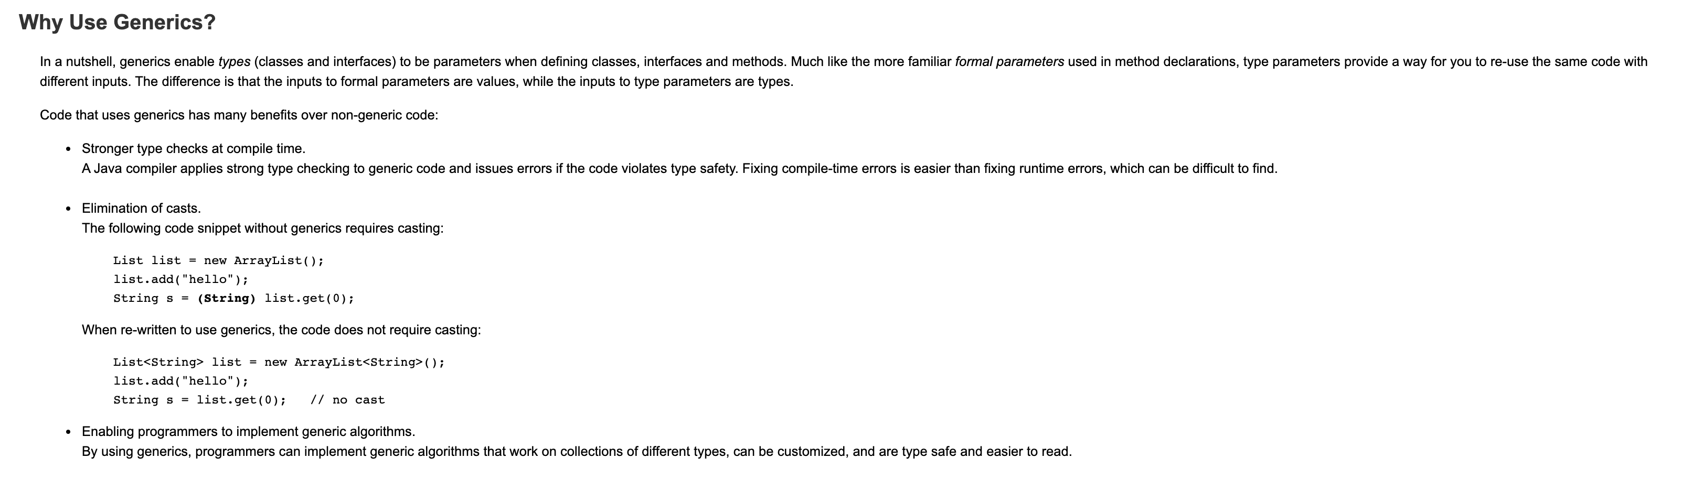
Generics
https://docs.oracle.com/javase/tutorial/java/generics/why.html

